Slide 1
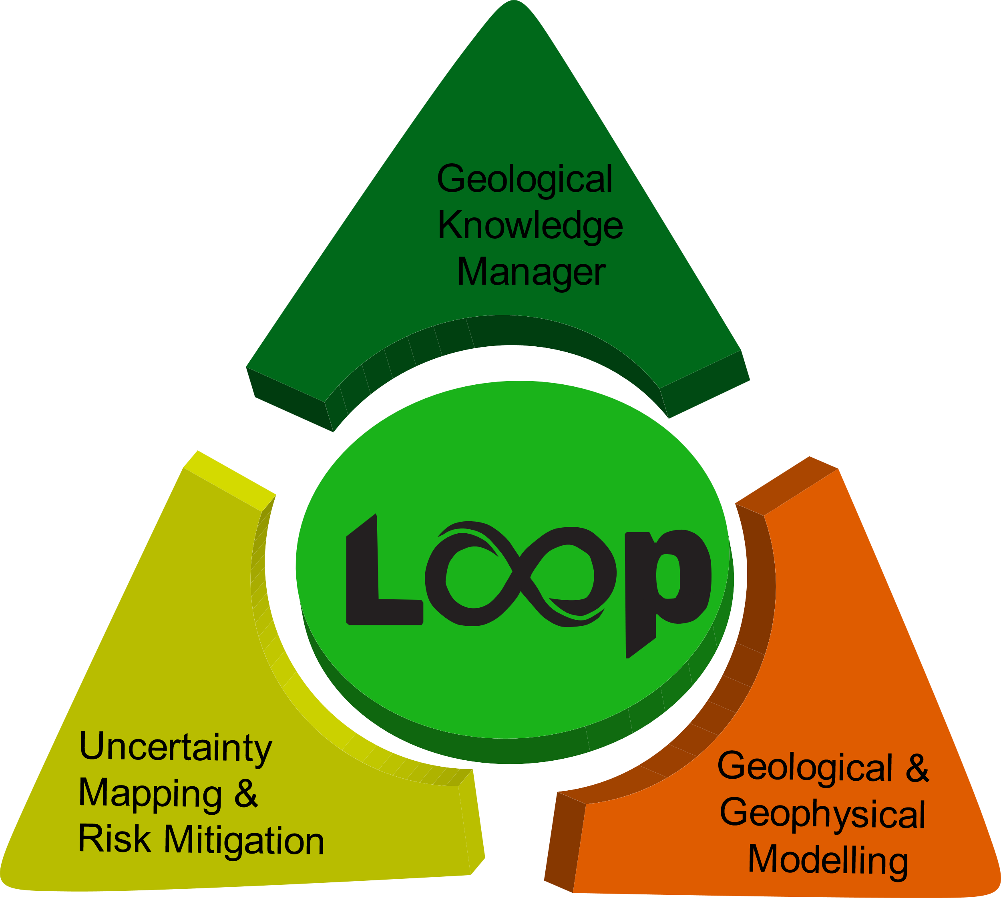



















The Loop project: Three-dimensional Bayesian Modelling of Geological and Geophysical data
Presented by: Laurent Aillères
for and on behalf of the entire Loop development team

Slide 2


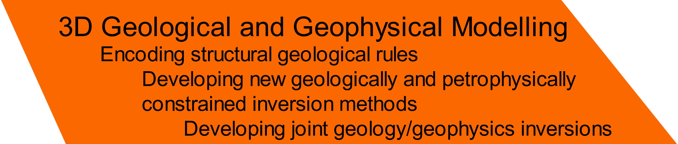


Loop3d.org
Open-source is the future github.com/Loop3D/
*
*
Findable, Accessible, Interoperable, Reusable

Slide 3
Loopers? Who are we?

Slide 4




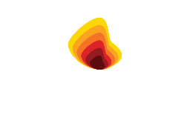




AuScope
$150K
ARC Linkage
EGF 3D fault model
$1,700K + $1,550K
$67K
Loop Portal
GSC Knowledge Manager
$200K
$400K
P6 & OP6
Loop & Thin Geology modelling
$2,100K
$200K
VOI
DECRA
GeoMos
$300K
$1,000K
DARE Data Analytics
$600K

Slide 5
Loop – Why a new platform?
Current technology does not allow for modelling of poly-deformed terranes in a reproducible sense
-> structural geology based modelling algorithm
Need for uncertainty characterisation
Need for better geophysical integration
Maximisation of 3D geology uncertainty reduction
This can only happen through automatisation of the modeling workflow
Open-source is the future github.com/Loop3D/

Slide 6
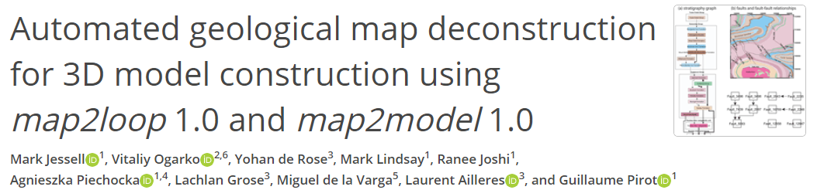
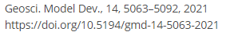
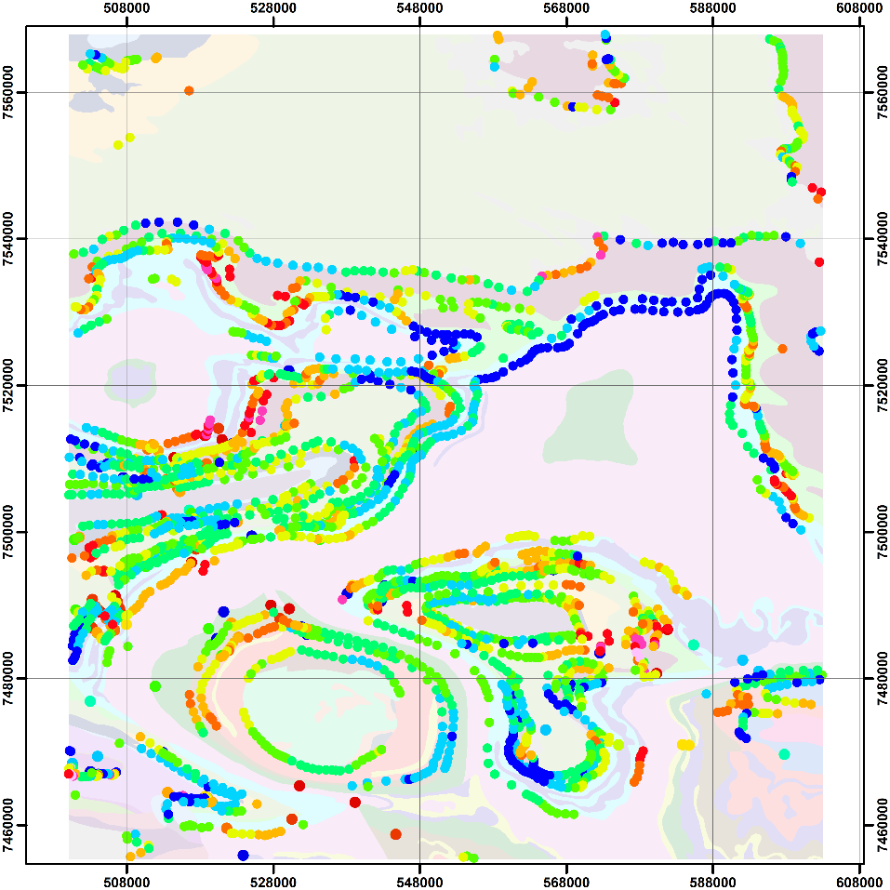
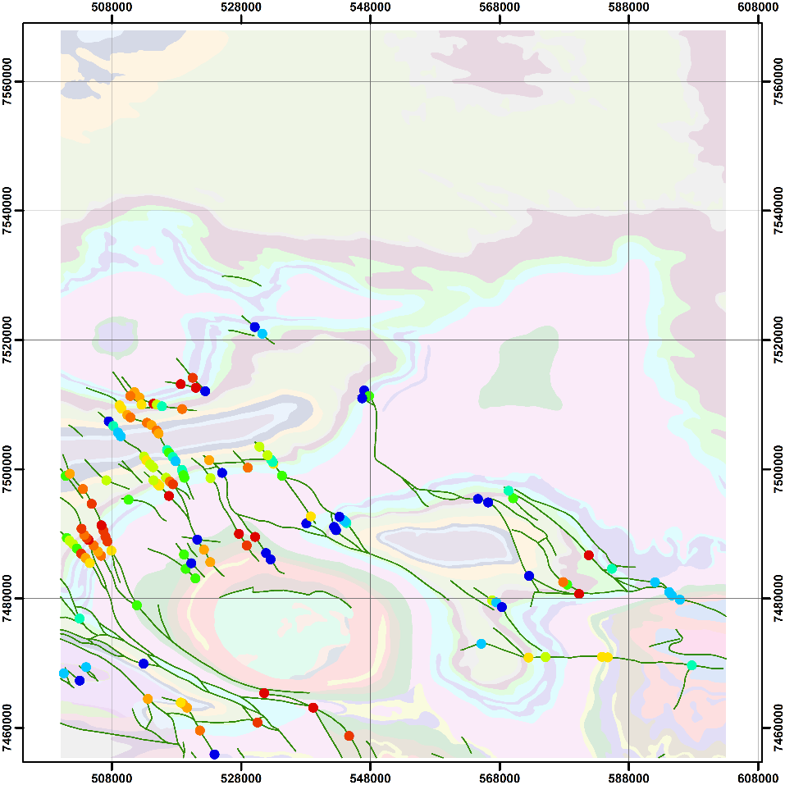
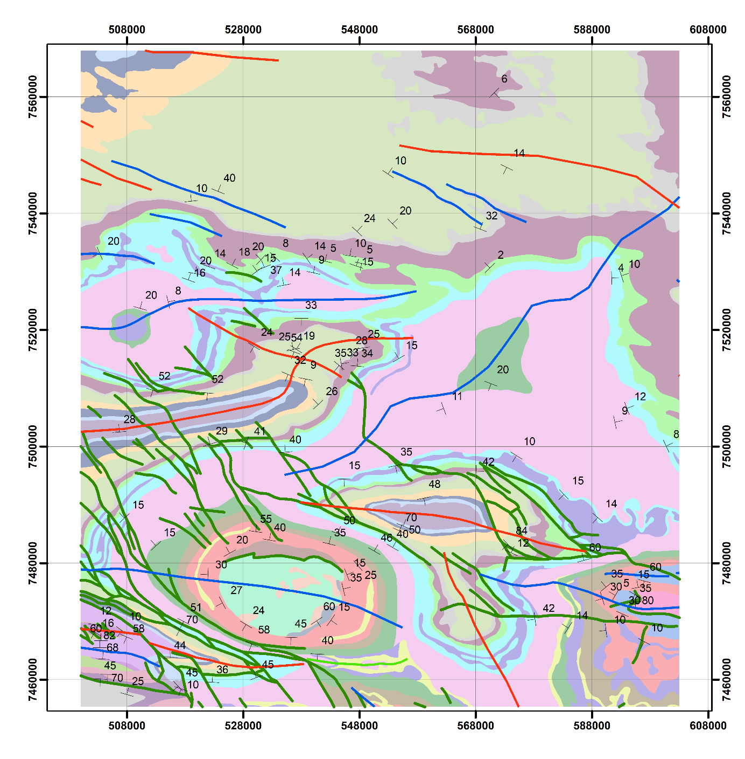
map2loop - Data Pre-Processing & input
Automation of data input for Loop’s modelling methods (LoopStructural)
Geometrical analysis of geological maps provides Fms thickness estimates and estimation of apparent fault offsets
Topological analysis of the geology map provides fault network relationships, fault formation relationships, intrusive and unconformable relationships
Secondary geological information automatically derived from maps. a) Normalised local formation thickness (hotter colours show thicker formations) b) Apparent fault throw (hotter colours show larger throw)
a
b

Slide 7
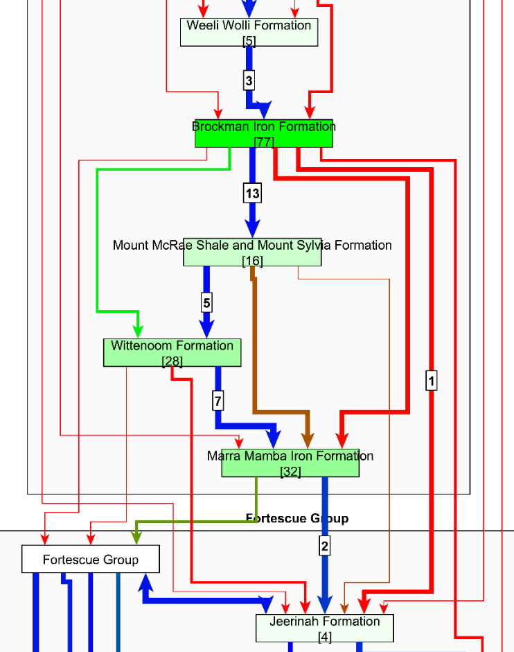
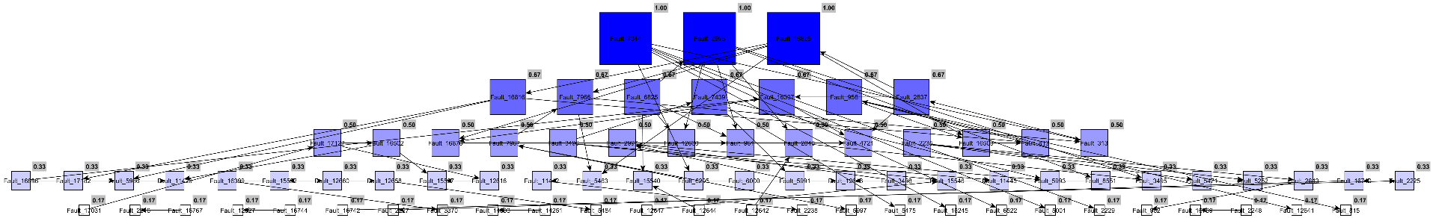
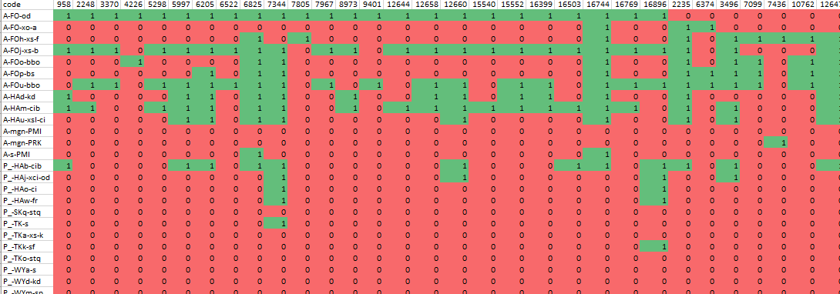
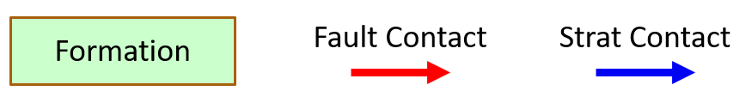
map2loop - Data Pre-Processing & input

Slide 8
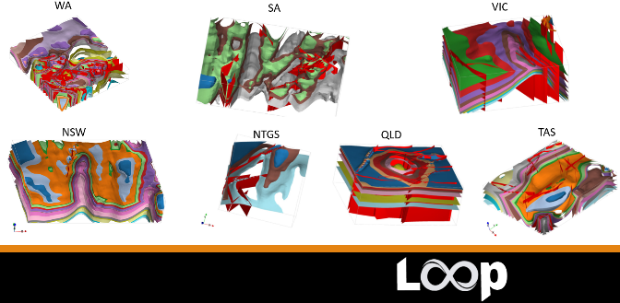

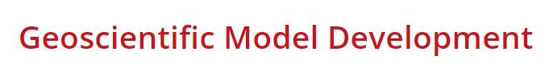
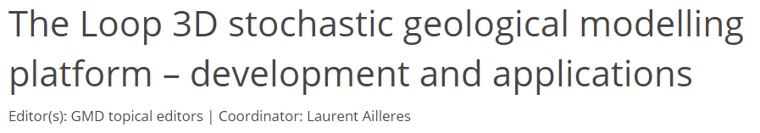
Automation of Geological Digital Twin(s)
Automated 3D model creation with the link: map2loop -> LoopStructural
m2l analysis and data augmentation
Data served by Geological Surveys in Australia
LoopStructural models calculated in a few minutes (inc. map2loop and loopstructural time) on a “normal” laptop
E.g. Flinders ranges: 10K+ orientation data points; overall time ~11 minutes (Dell Inspiron 15).

Slide 9
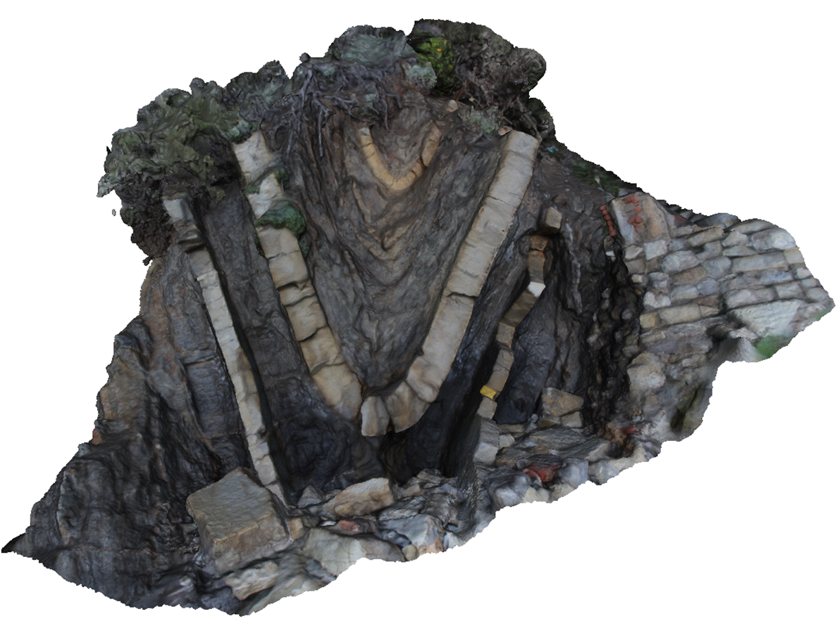
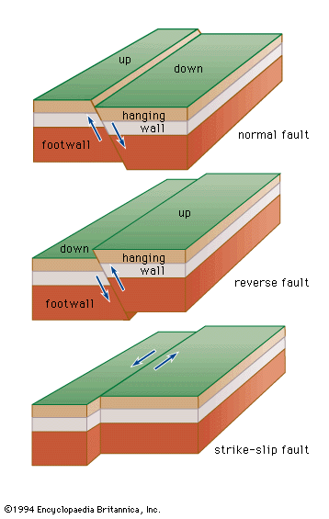
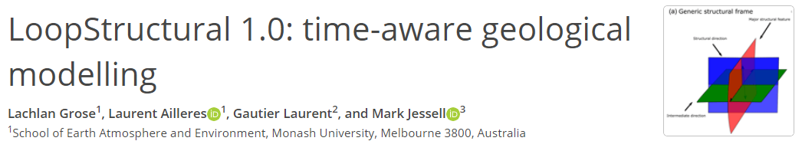
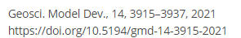
The Structural Frame concept
Three coordinates – three scalar fields
Major structural feature
fault surface
fold axial surface
intrusion major axis
Structural direction
fault slip direction
fold axis
intrusion flow direction
Additional direction (if required)
Fault , e.g. fault extent

Slide 10
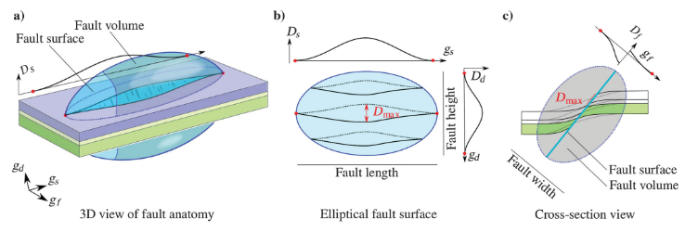
The Fault Frame
Godefroy et al 2018

Slide 11
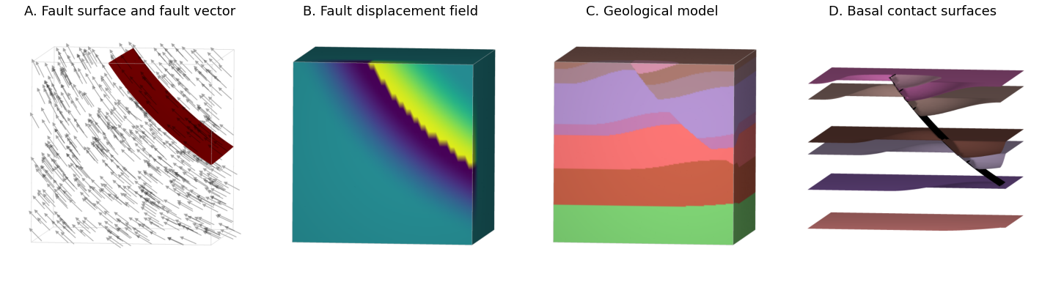
The Fault Frame
Preprint

Slide 12
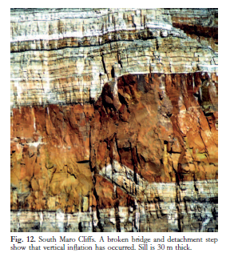
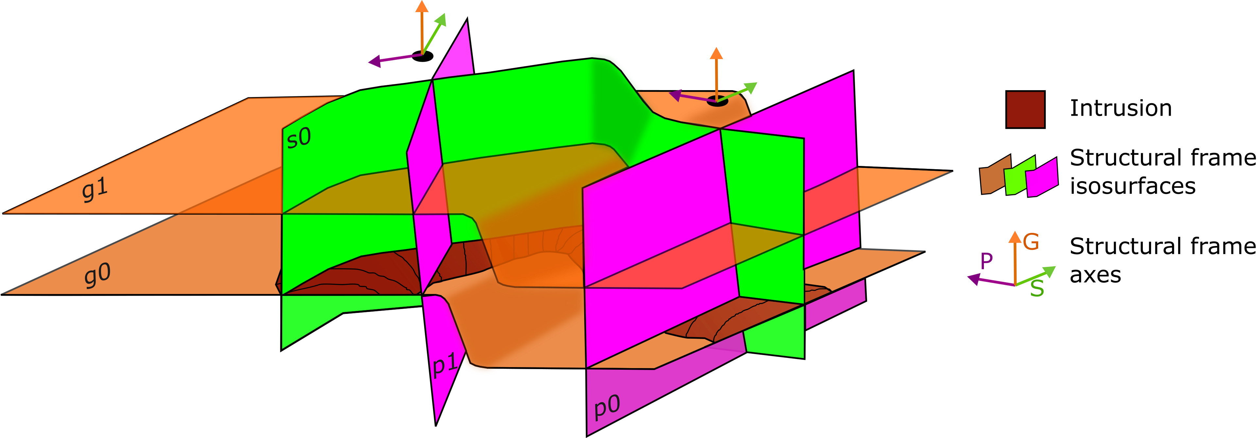
Intrusion Structural Frame
Magma flow
Step geometry, sill (Hutton, 2009)
Fernanda Alvarado-Neves (PhD candidate, Monash University

Slide 13
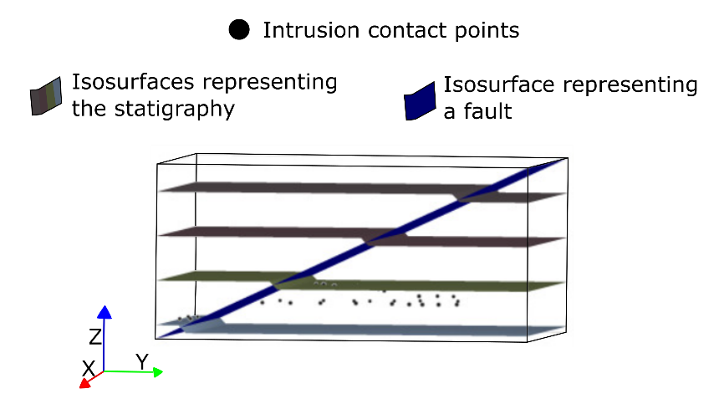
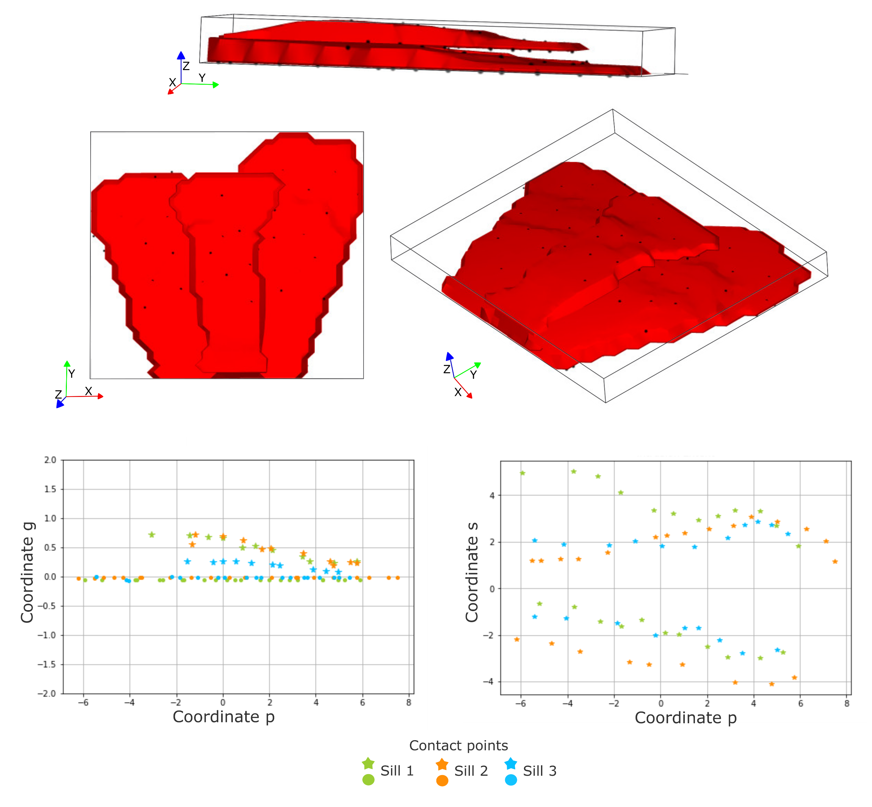
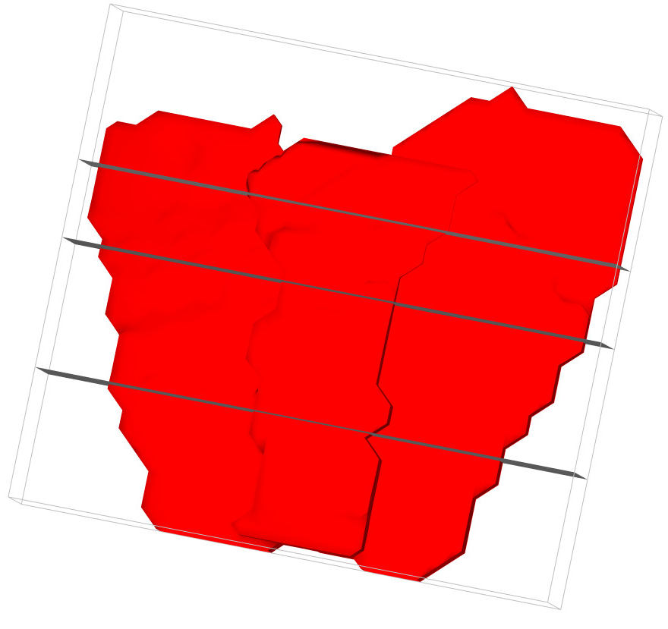
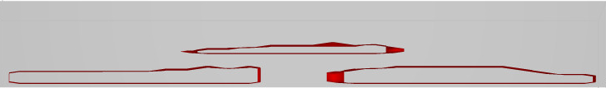
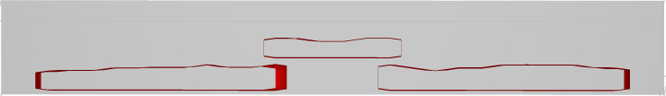

Intrusion Structural Frame
Magma flow
Fernanda Alvarado-Neves (PhD candidate, Monash University
Step geometry, sill (Hutton, 2009)

Slide 14
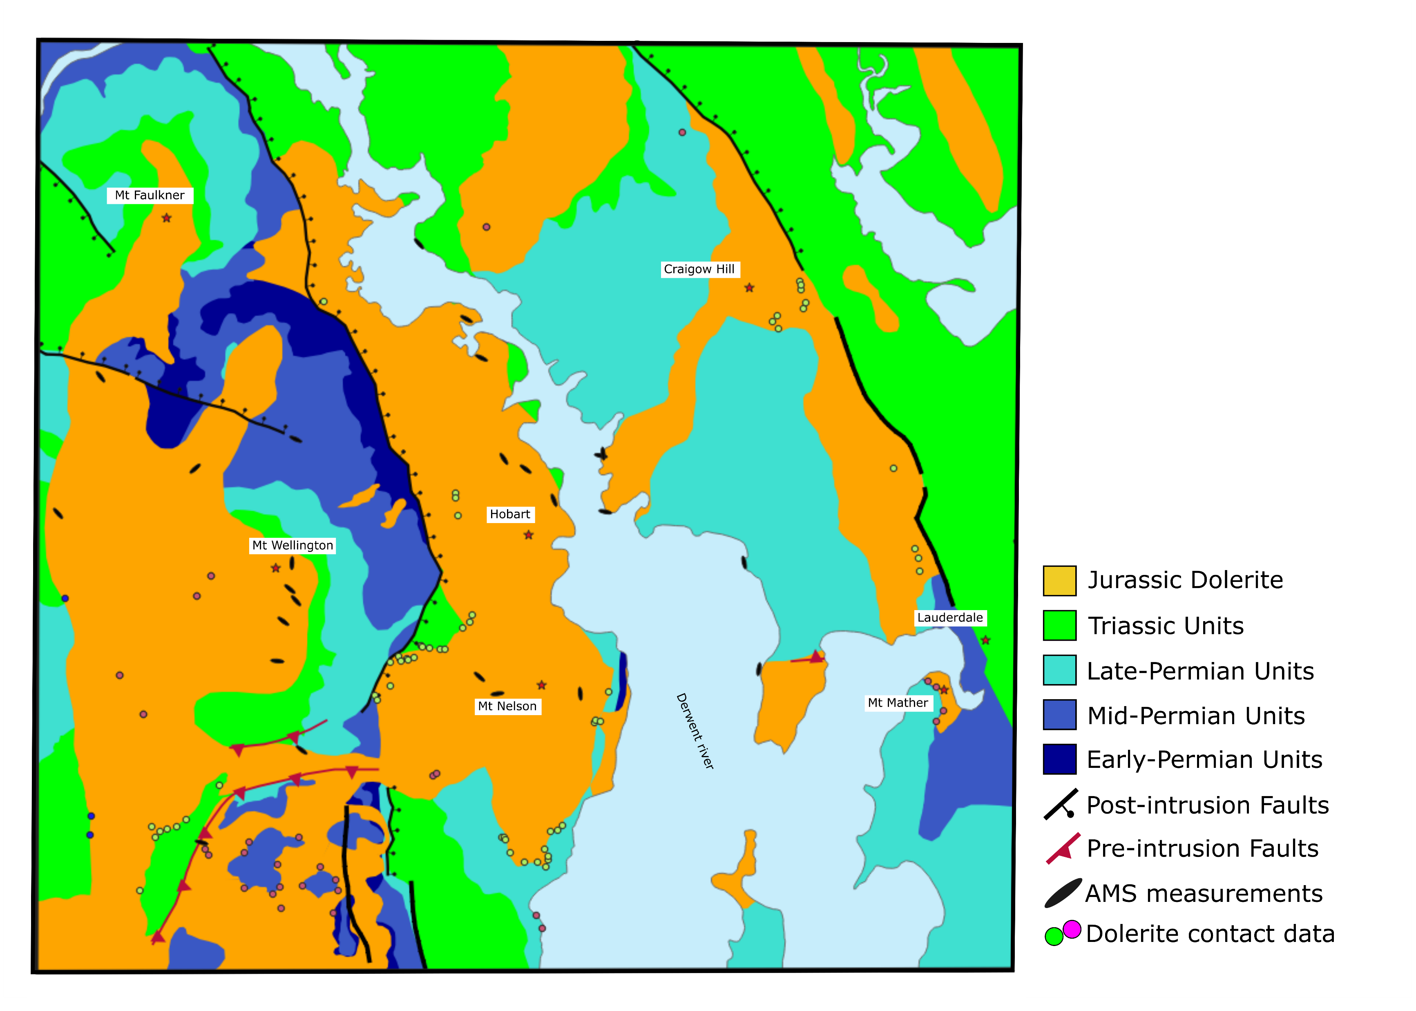
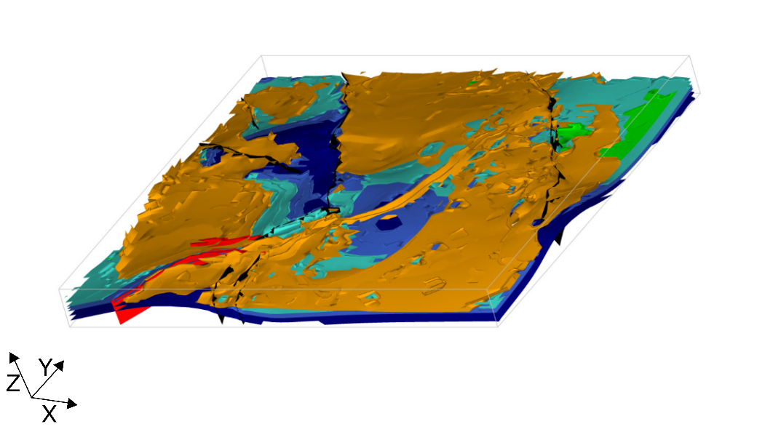
Intrusion Structural Frame
Fernanda Alvarado-Neves (PhD candidate, Monash University
N

Slide 15
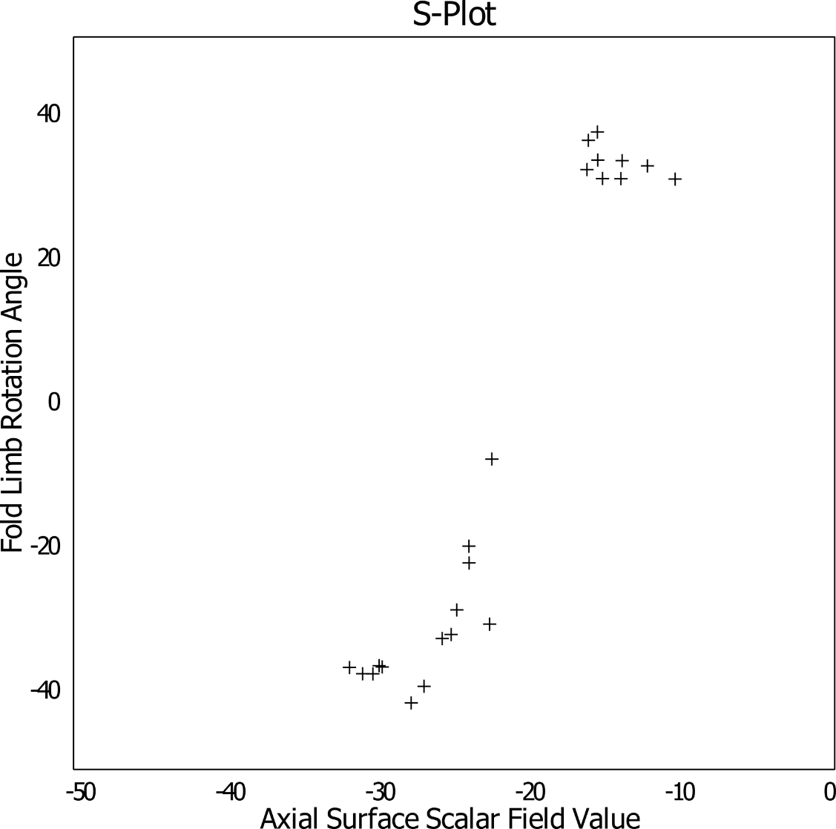

Fold structural frame
Point of inflection?
Hinge
Limb
Point of inflection?
½ Wavelength

Slide 16
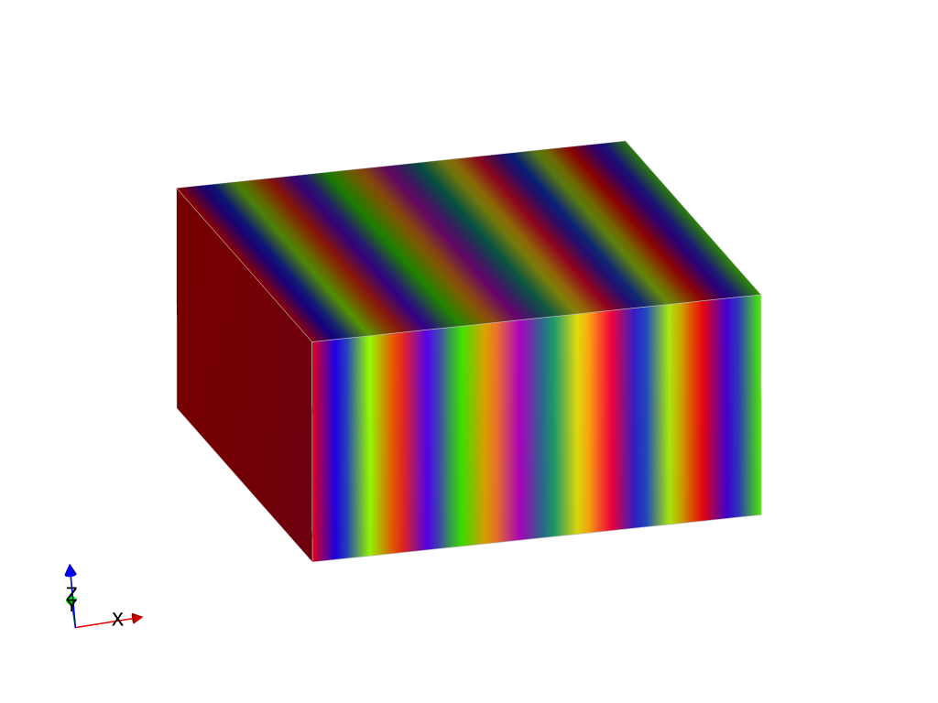
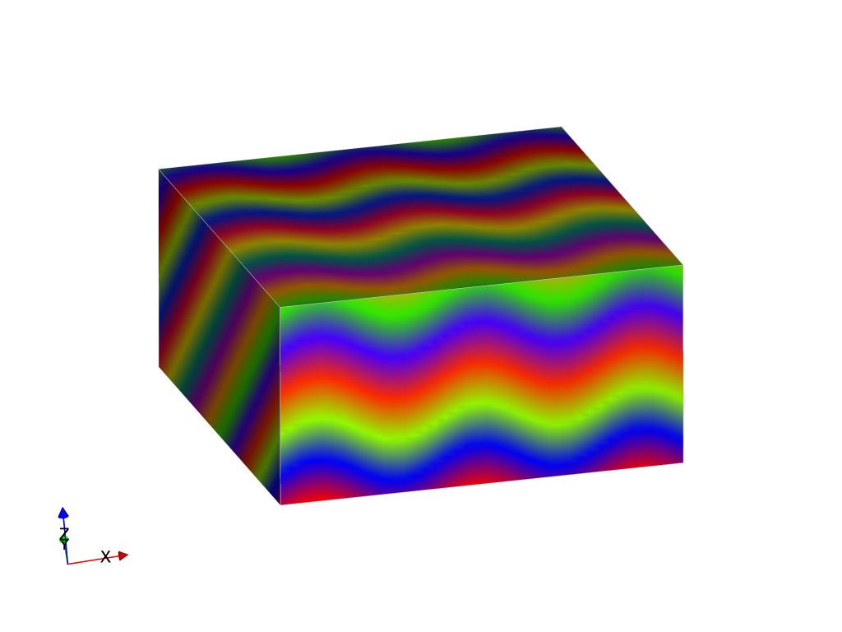
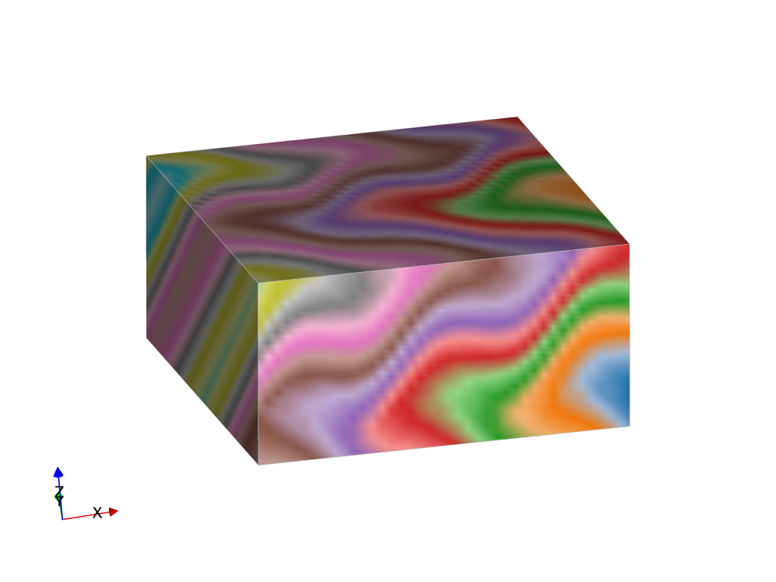
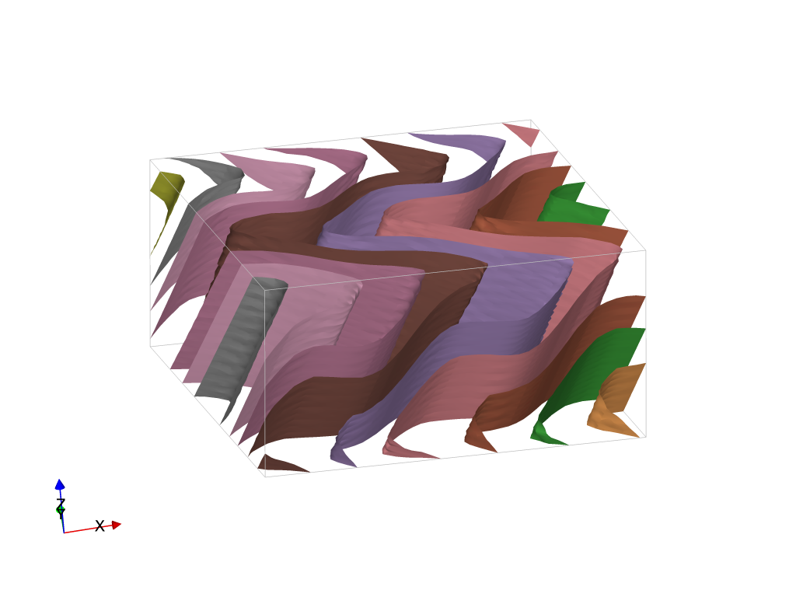
Time-aware Geometrical modelling – combining structural frames
Poly-deformation:
Modelling events step by step
Time-aware process: youngest event is modelled first, then the second youngest, etc… until the primary foliation (most often bedding) is modelled
Modelling is geometry based (not mechanical)
Event types:
each fault or family of faults
Folding event
Unconformity
Intrusions
S2⁺
S2
S1⁺
F2
S1⁺
S1
S0⁺
F1
S0⁺
S0
Laurent et al., 2016, EPSL

Slide 17
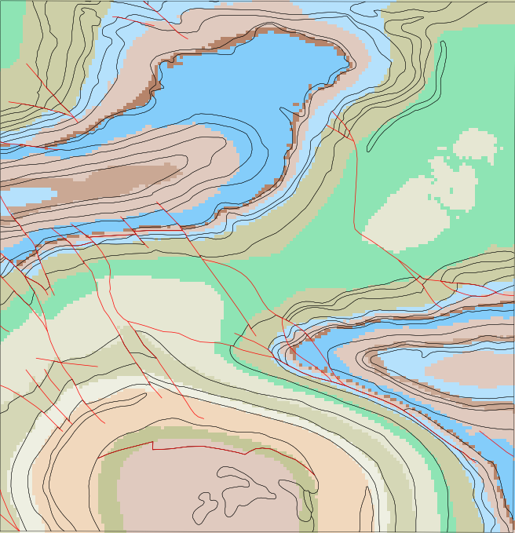
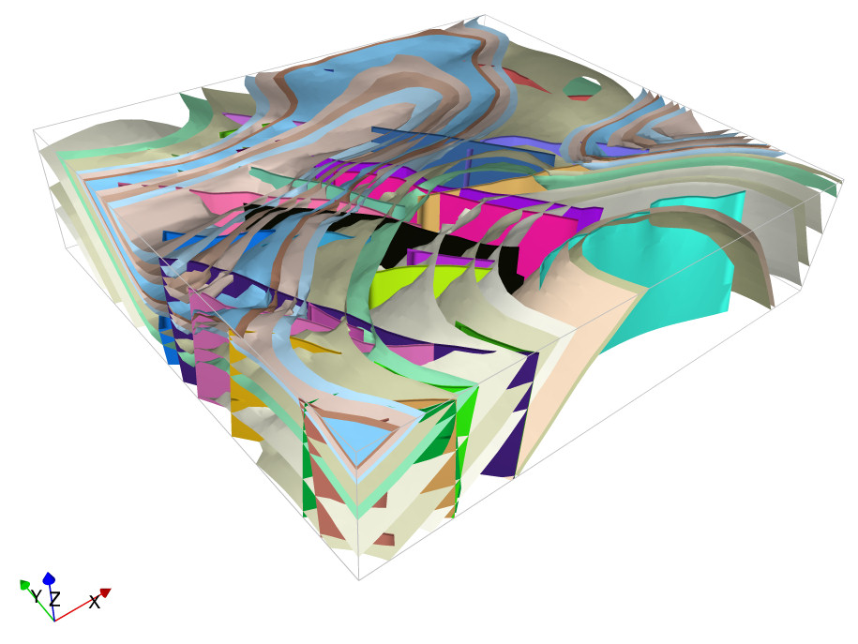
LoopStructural
5x v.e.
~15 minutes from raw data
(6 mins map2loop, 9 mins LoopStructural)
Comparison between top surface of model and map

Slide 18
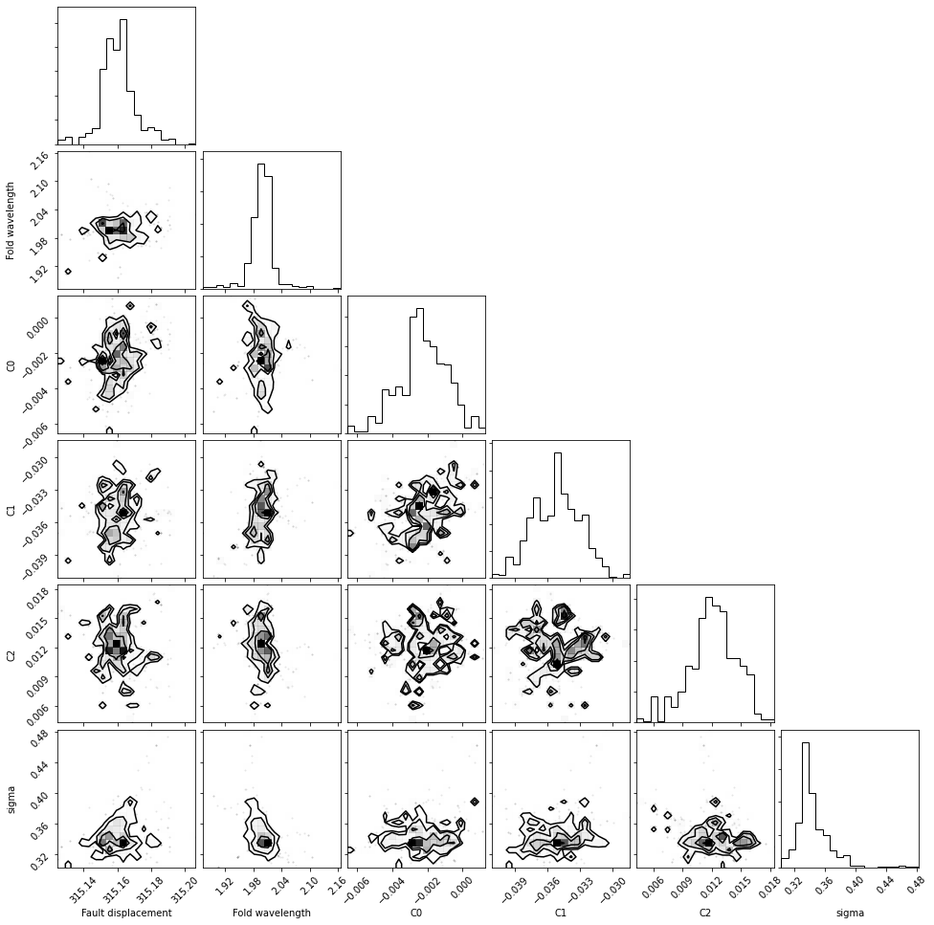
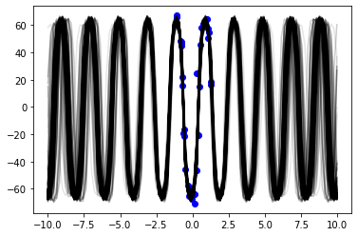
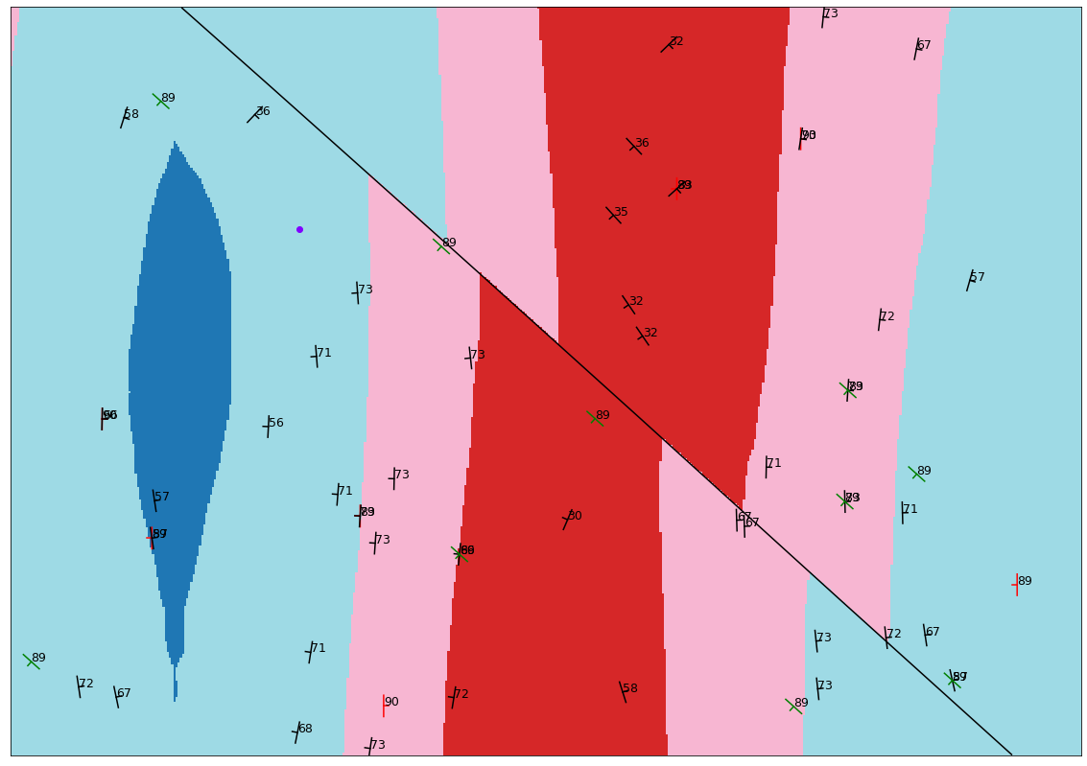
Proof of concept - Bayesian LoopStructural
Bayesian modelling – proof of concept
Faulted fold series
Posterior probabilities for displacement and Fourier series coefficients
S-Plot showing 1000 realisations of the fold profile sampled from the posterior distribution.
c

Slide 19
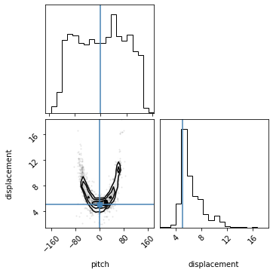
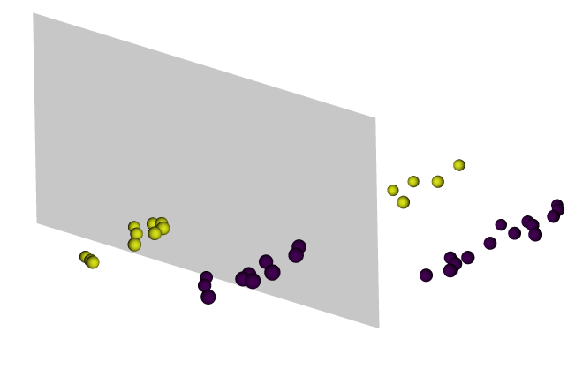
Inverting for geometry
We are building an inversion scheme for geology based on probabilistic (Bayesian) modelling
Map2loop can provide a-priori probability density functions for some of the parameters.
Users can also define these pdfs from accumulated knowledge.
Laurent et al., 2016, EPSL

Slide 20
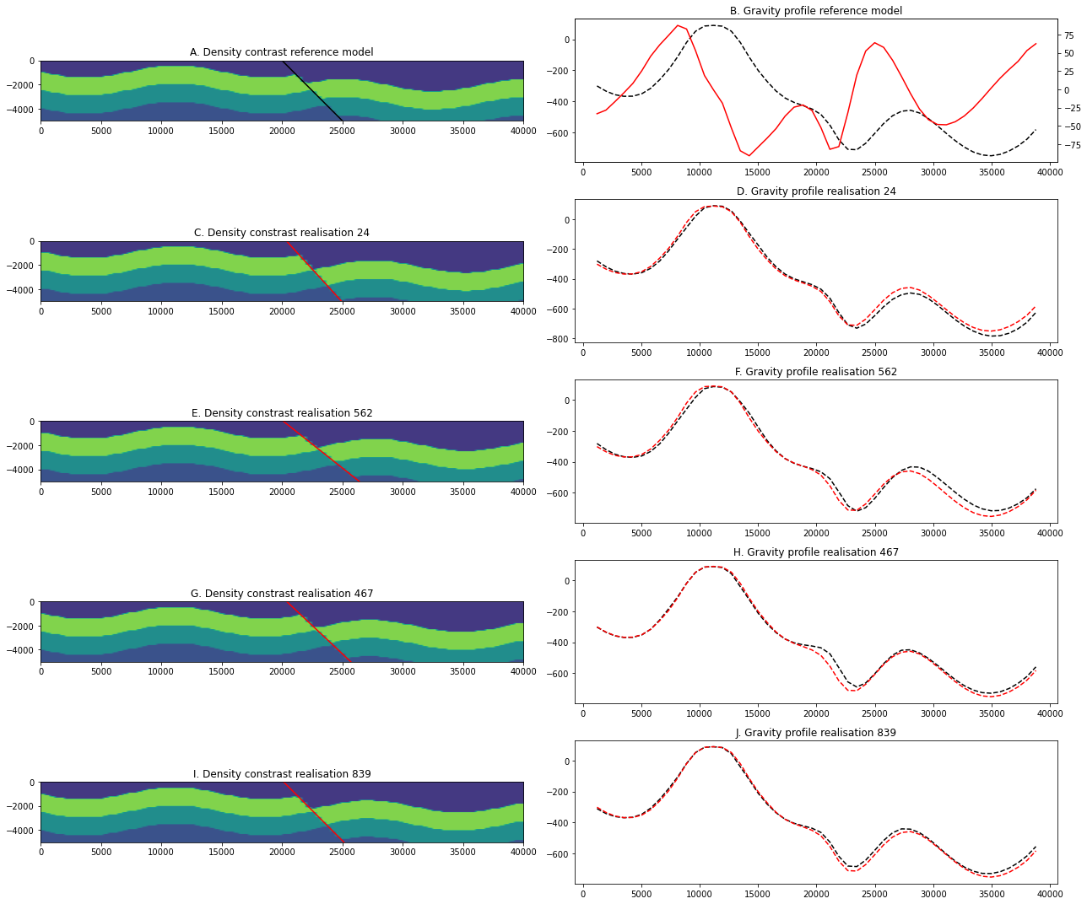
Inverting for geometry
Synthetic example of faulted folded layered model.
Trying to recover fault location, dip and displacement from a gravity profile.
Folded layered model with known density distributions
Likelihood = misfit between observed and calculated gravity
Multiple mcmc chains

Slide 21
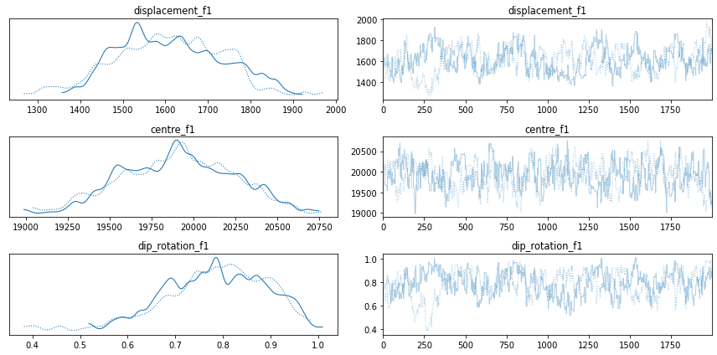
Inverting for geometry
Synthetic example of faulted folded layered model.
Trying to recover fault location, dip and displacement from a gravity profile.
Folded layered model with known density distributions
Likelihood = misfit between observed and calculated gravity
Multiple mcmc chains

Slide 22
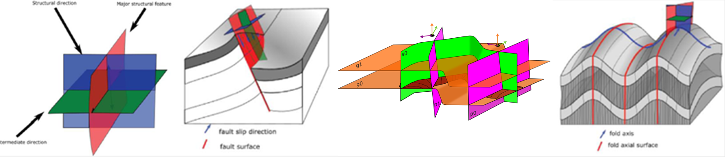
Reducing the Mining Footprint
LoopResources
an automated, reproducible, update-able, workflow to model geology based on structural geological rules
integration with geophysical modelling (early piecewise inversions or late level-set inversions)
a characterisation of uncertainty that will guide further data acquisition (where and what)
AND a framework using structural frames to model ore body properties including: lithology, alteration, mineralogy, metallurgy, geotechnical parameters and grades

Slide 23
Reducing the Mining Footprint
LoopResources
The Loop Vision:
Create more realistic digital-twin of the geology at all scales
Help and optimise decision making related to managing our resources
For example, at the mine scale:
Optimise drilling from 1st intersection
Propagate and consider uncertainty throughout the modelling process, including property modelling
Increase recovery rate
Decrease the amount of resources needed to extract (less energy for less drilling, optimised crushing and processing chain, less water…
Optimising the extraction of resources for a greener tomorrow

